Slide 1

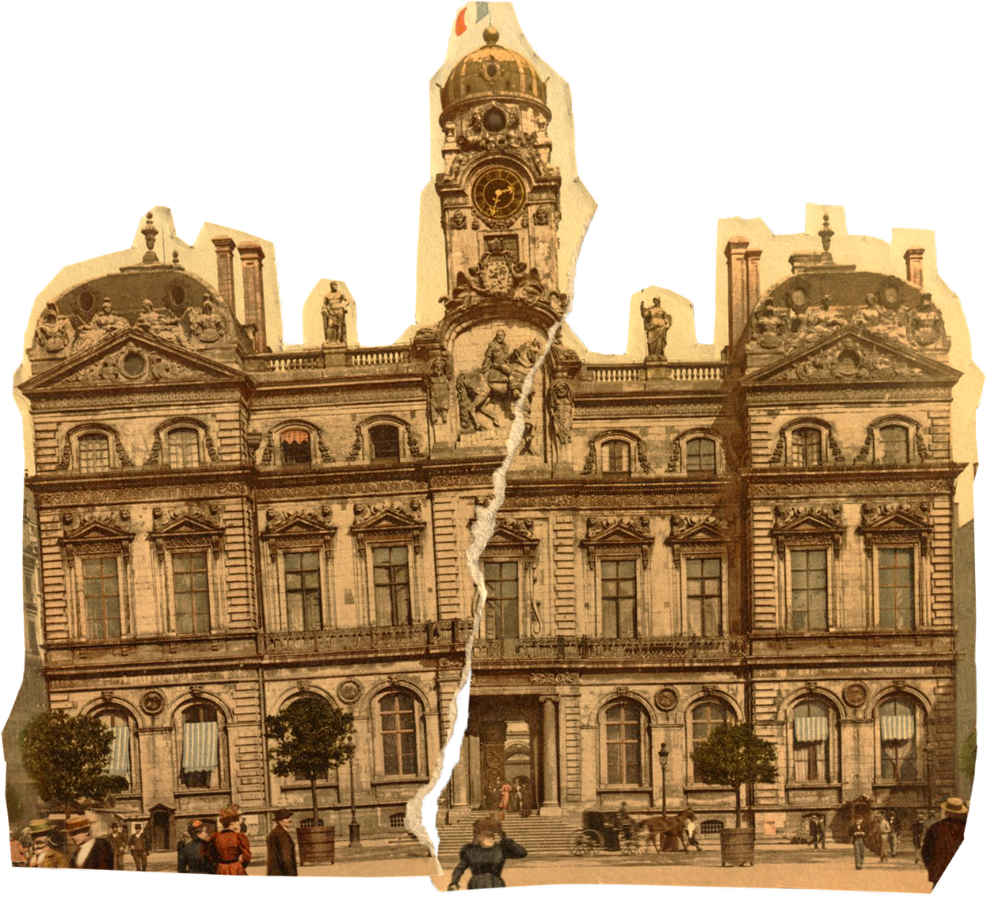


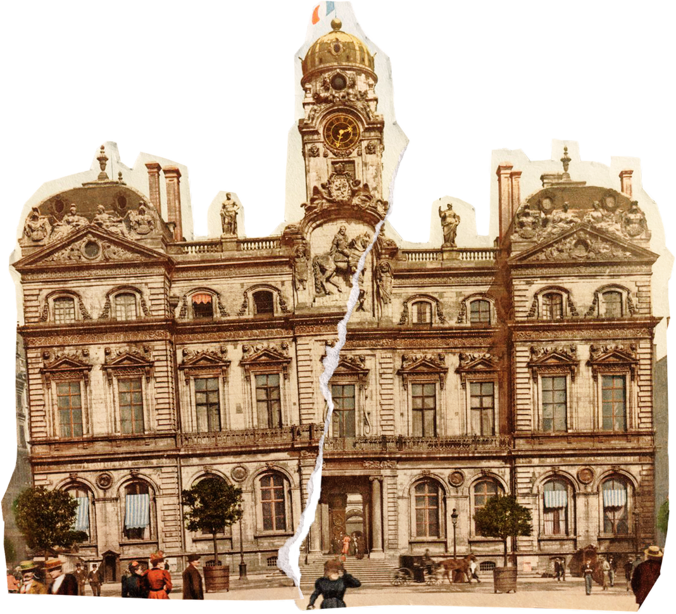


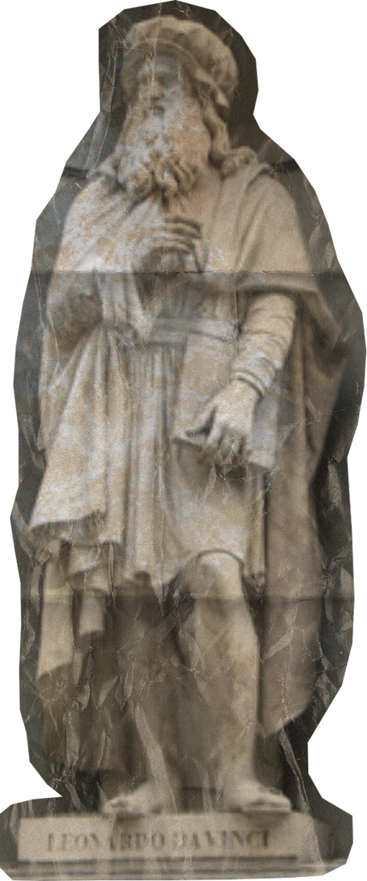

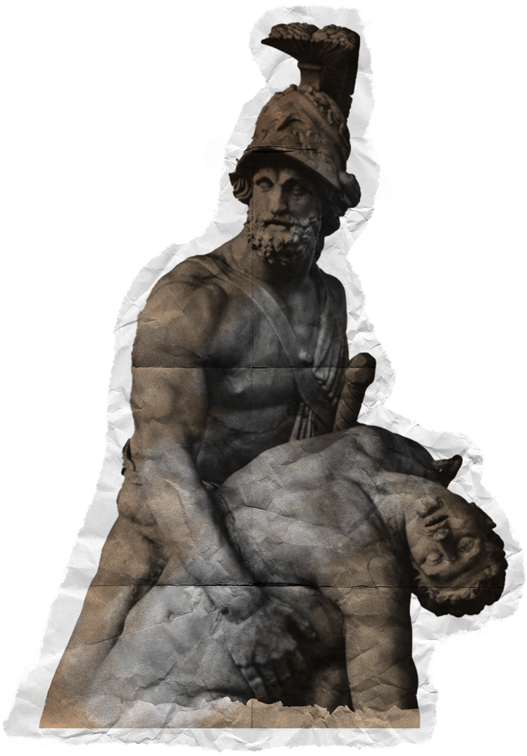
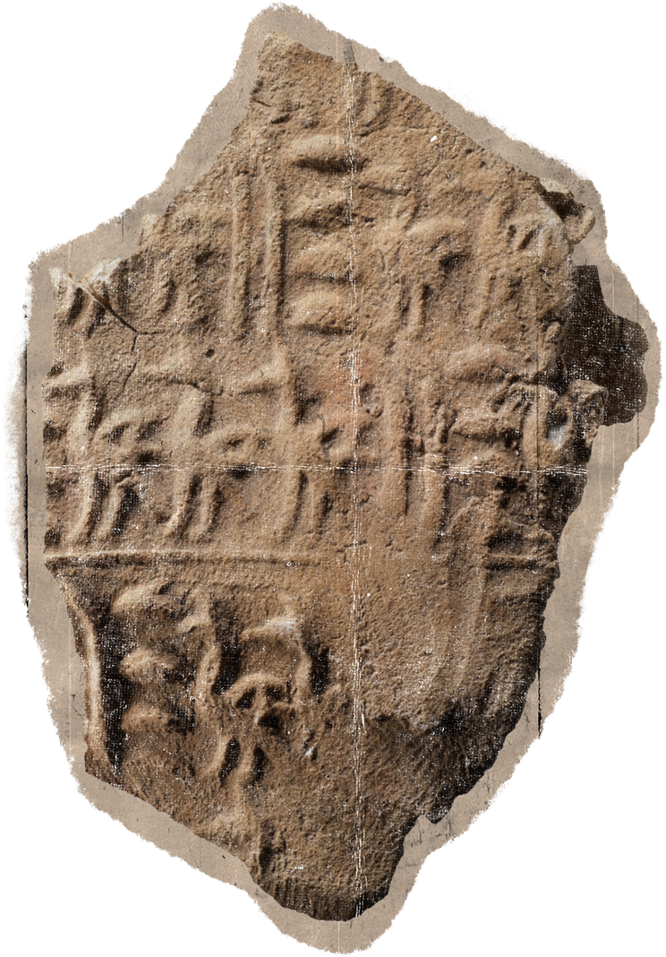
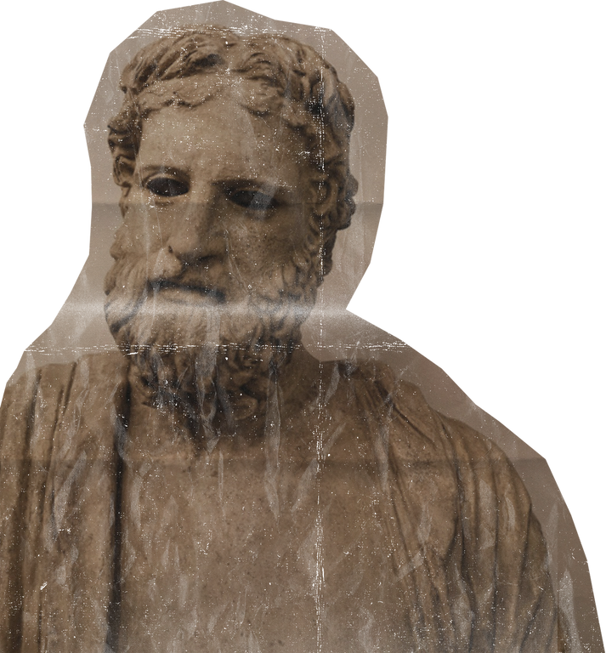


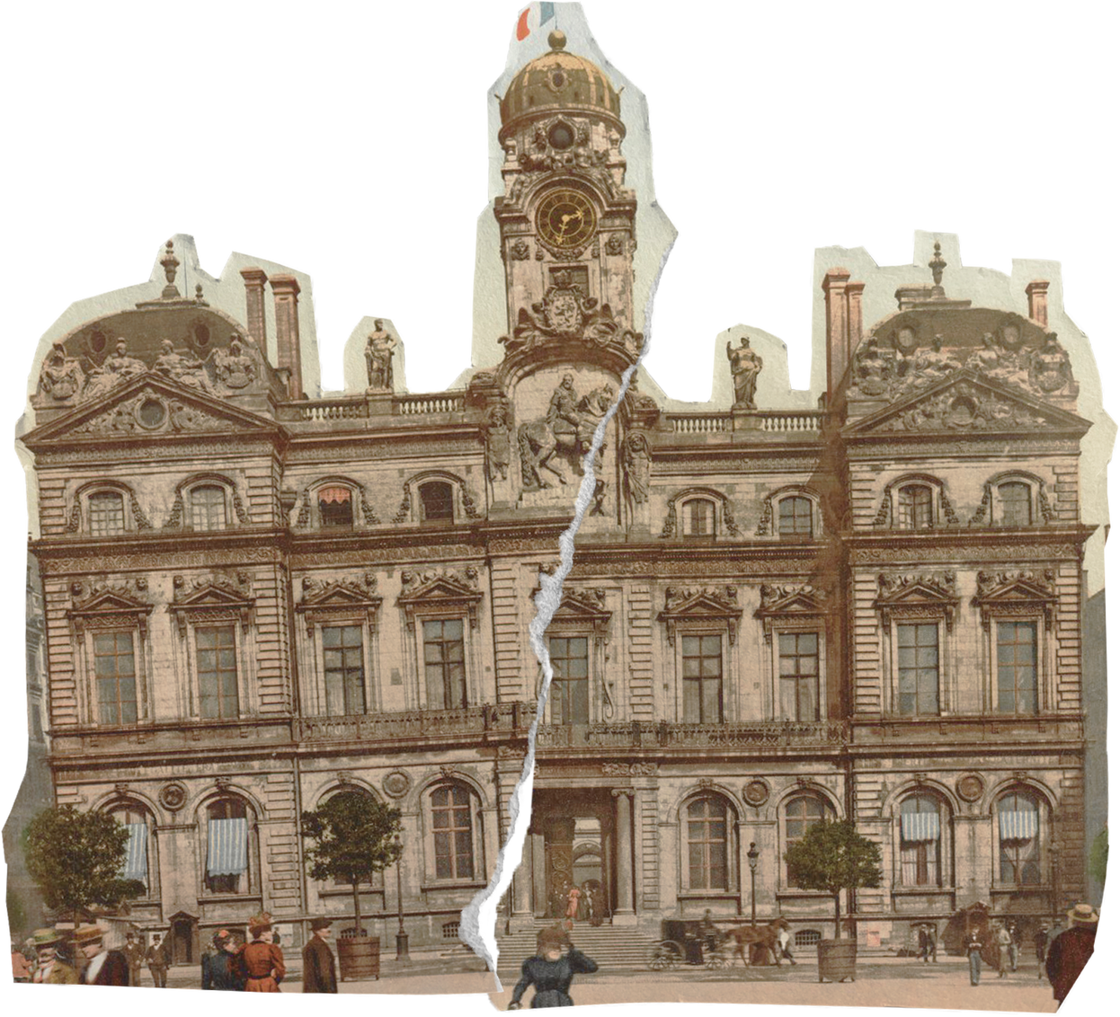

HISTORY
Greek Influence on
Roman Art
How Greek Culture Shaped Roman Creativity
by: Group 7

Slide 2
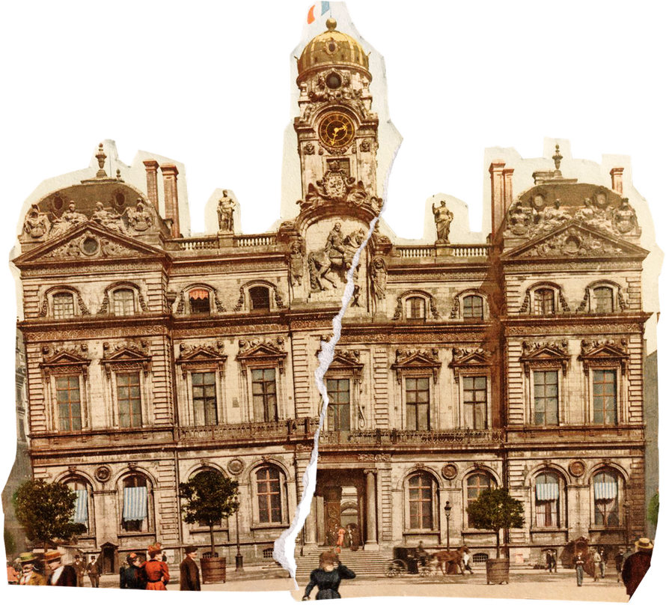
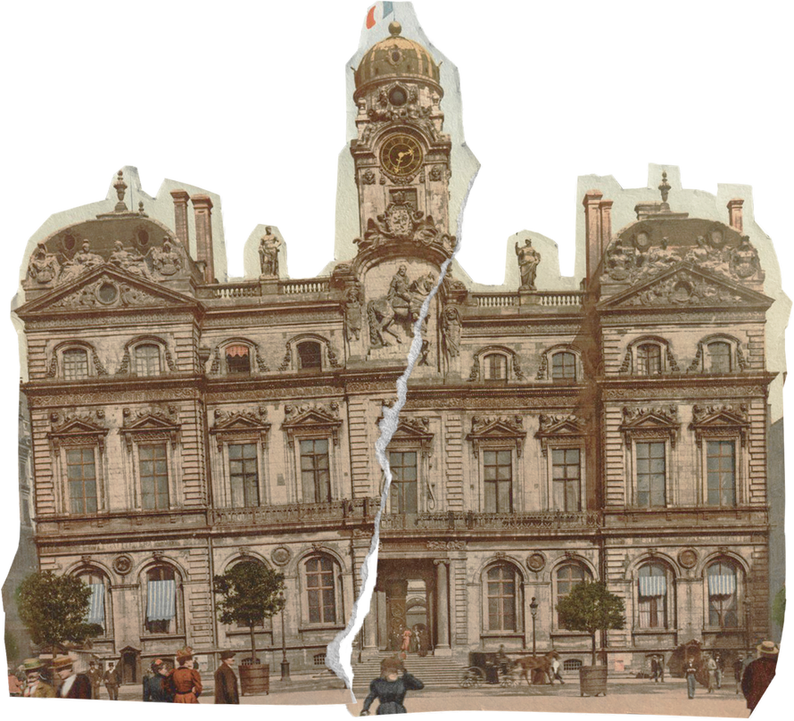

INTRODUCTION
Roman art was deeply influenced by Greek culture, particularly after Rome expanded into Greek territories in the 2nd and 1st centuries BCE. Greek art emphasized idealized forms, proportion, and realism, which fascinated the Romans. Instead of merely copying, Roman artists modified Greek techniques to reflect Roman values such as authority, leadership, and civic pride. Understanding this influence helps us see how two great civilizations shaped Western art.

Slide 3
Why Romans Admired Greek Art
The Greeks were renowned for creating realistic and idealized representations of the human form. Their sculptures captured movement, balance, and anatomical accuracy, embodying beauty, harmony, and perfection. Romans admired these qualities and recognized that Greek art could enhance their image of sophistication and power. By adopting Greek styles, Roman leaders and patrons used art to display wealth, political authority, and cultural refinement.

Slide 4
Painting & Mosaics
Greek influence also extended to Roman painting and mosaics. Romans adopted Greek techniques of realism and proportion, often depicting mythological scenes and everyday life with careful attention to detail. Frescoes and mosaics decorated private homes, public buildings, and temples, reflecting both Greek artistic ideals and Roman tastes. Examples include the Villa of the Mysteries fresco in Pompeii and mosaics showing Greek myths, which demonstrate the Romans’ ability to adapt Greek styles while making them distinctly their own.

Slide 5
Cultural Exchange
The cultural exchange between Greece and Rome was facilitated by conquest, trade, and education. Greek artists, philosophers, and architects were often brought to Rome, introducing new techniques and ideas. This interaction allowed Roman art to evolve beyond simple imitation; it became a sophisticated combination of Greek aesthetic principles and Roman pragmatism. Through this exchange, Roman art not only reflected Greek influence but also served as a tool for political messaging, social identity, and public life.

Slide 6
Key Takeaways
Roman art was heavily inspired by Greek sculpture, architecture, and painting.
Romans copied Greek models but added their own styles to suit political, social, and functional purposes.
Greek influence helped Rome convey authority, sophistication, and cultural superiority.
By studying this influence, we can understand how cultural exchange shaped Western art and the enduring legacy of both civilizations.

Slide 7
Quiz Slide
Can you identify the Greek influence in these Roman artworks? Look at the poses, facial expressions, and details. Compare a Roman bust with a Greek original and notice similarities in anatomy, proportion, and style?

Slide 8
HISTORY
Want affordable and quality presentations?
Find it in Nonex
https://nonex.onrender.com
THANK YOU
SO MUCH!
made with nonex
by: Group 7

